Slide 1




Scuola di Specializzazione in
Medicina di Emergenza e Urgenza
Università di Perugia
9 Maggio 2016
Medicina intensiva nell’anziano:
tra linee-guida e ageismo
Niccolò Marchionni
Ordinario di Geriatria, Università di Firenze
Direttore Dipartimento Cardio-Toraco-Vascolare
Azienda Ospedaliero-Universitaria Careggi
Past-President, Società Italiana di Cardiologia Geriatrica (SICGe)
Chaiperson, Geriatric Expert Group, European Medicines Agency, London

Slide 2
AGEISM
An attitude that discriminates, separates, stigmatizes, or otherwise disadvantages older adults on the basis of their chronologic age
Mosby's Medical Dictionary, 8th edition. © 2009, Elsevier.
http://medical-dictionary.thefreedictionary.com/ageism
last accessed Sept 23, 2013

Slide 3


Sunday 18 July 2010
Robert Butler obituary
Doctor who worked to change perceptions of ageing and the aged
Robert Butler, Aging Expert, Is Dead at 83
By DOUGLAS MARTIN Published: July 7, 2010
… Dr. Butler’s influence was apparent in the widely used word he coined to describe discrimination against the elderly: “ageism” …
Robert Neil Butler
(Jan 21, 1927 – † Jul 4, 2010)
Age-ism: another form of bigotry
Butler RN.
Gerontologist 1969;9(4):243-6.
PMID: 5366225 PubMed-MEDLINE
First Director of the
http://www.nia.nih.gov/

Slide 4
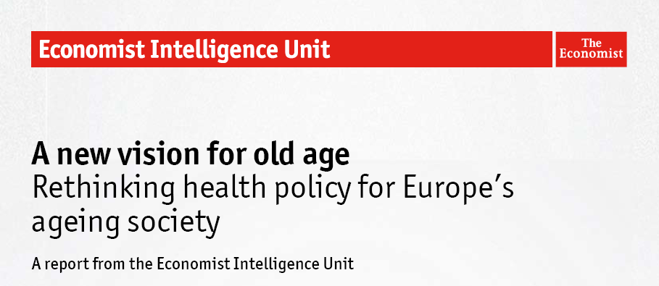
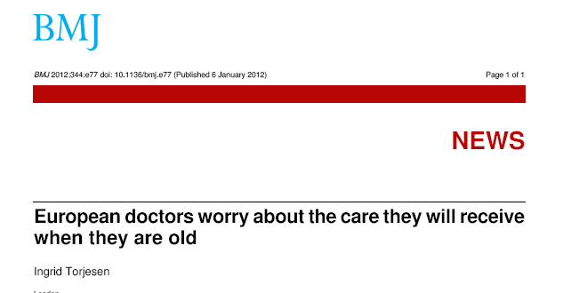
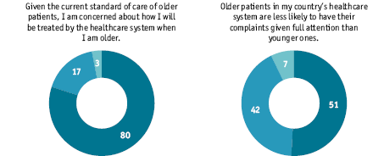
Posted 4 Jan 2012
Published 6 Jan 2012
1113 MDs surveyed
Given the current standard of care of older patients, I am concerned about how I will be treated by the healthcare system when I am older.
Older patients in my country’s healthcare system are less likely to have their complaints given full attention than younger ones.
Show ageism the door. …survey respondents believe that negative attitudes towards older people constitute the leading barrier to the provision of better care … ageism is a “huge problem” across Europe…
Yes
No
Don’t know

Slide 5
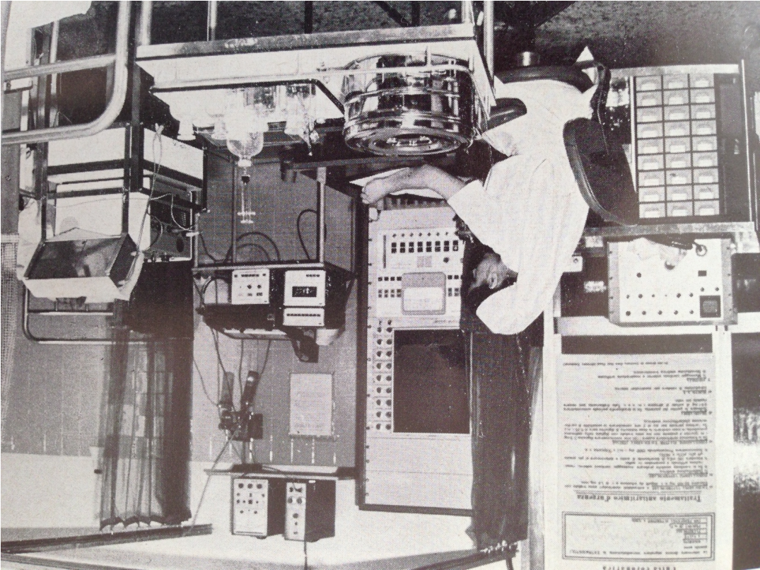
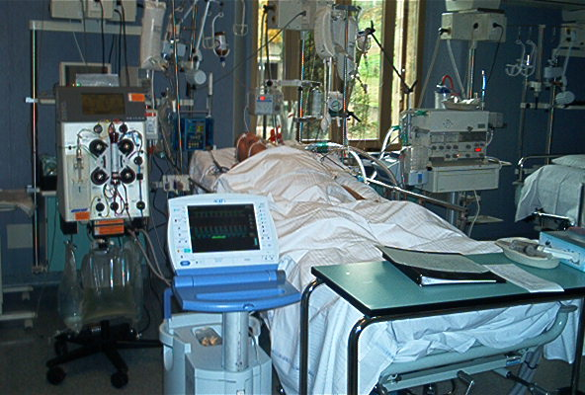
Lo scenario (1):
ICU Geriatria Firenze
Anni ‘90 - High-tech:
supporto a circolo, polmoni, rene
(+ PCI)
Anni ‘70 - Low-tech:
ECG, pacemaker, defibrillatore, monitoraggio emodinamico

Slide 6
Lo scenario (2):
anziani oltre il 60% dei ricoveri in Terapia Intensiva
Gruppo italiano per la Valutazione degli interventi in Terapia Intensiva (GiViTI), 2008
http://www.giviti.marionegri.it/

Slide 7
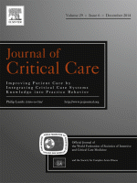
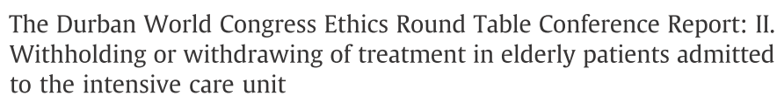

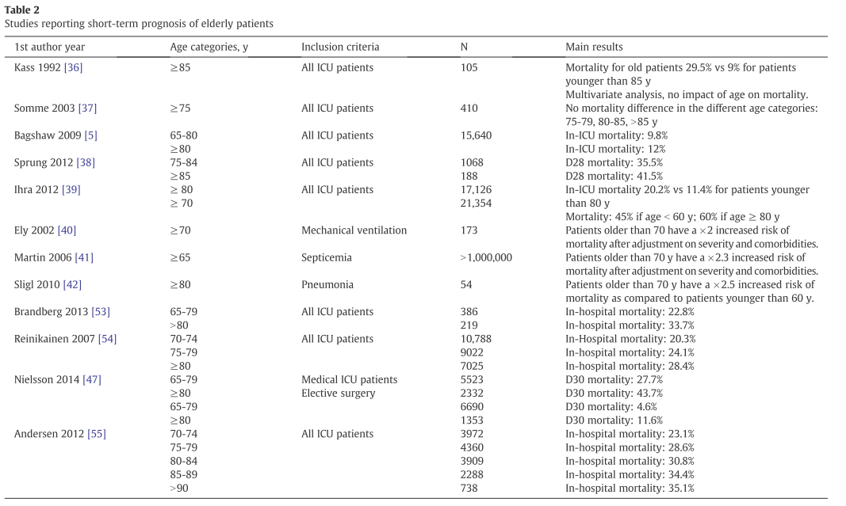
> Age > Mortality

Slide 8
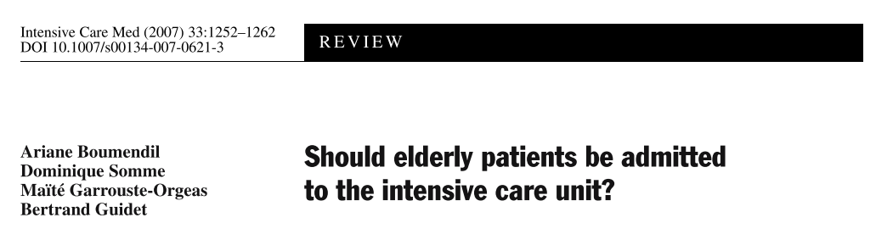

Edvard Munch, L'Urlo
(1893, particolare)

Slide 9
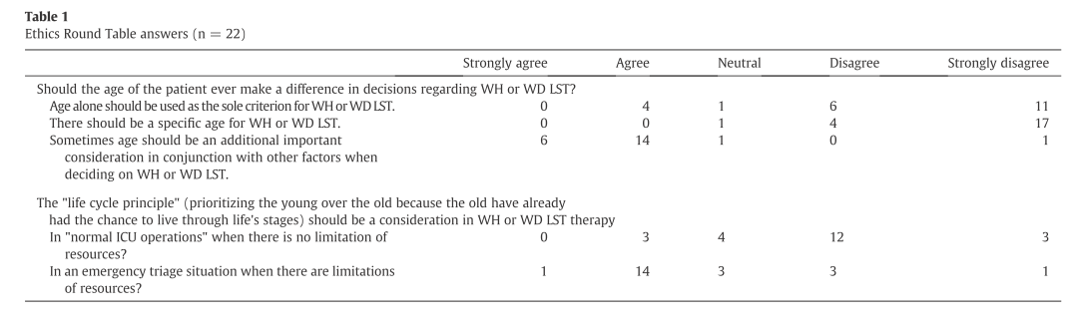
Conclusions: there is a consensus among ICU physicians that age cannot be the sole criterion on which health care decisions should be made
... ma, in pratica che succede?

Slide 10
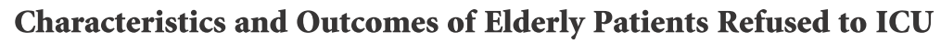
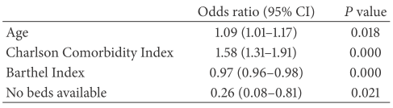
Pintado MC et al The Scientific World Journal 2013
Factors associated with ICU refusal

Slide 11
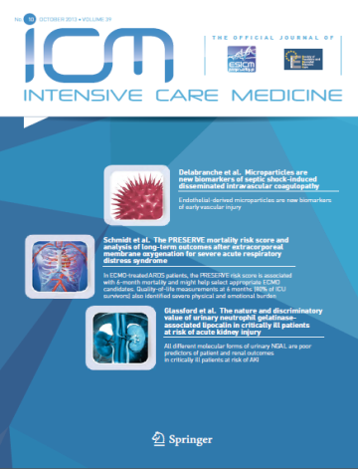
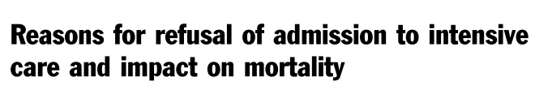
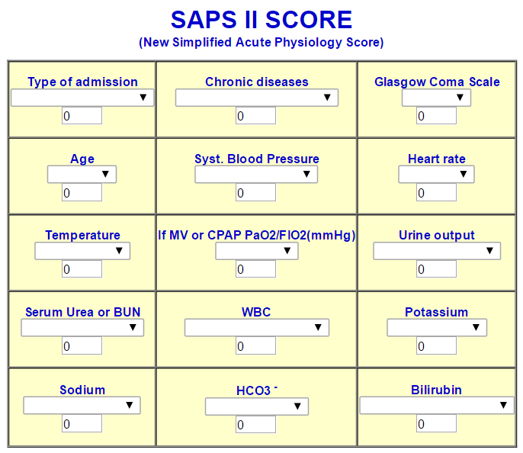
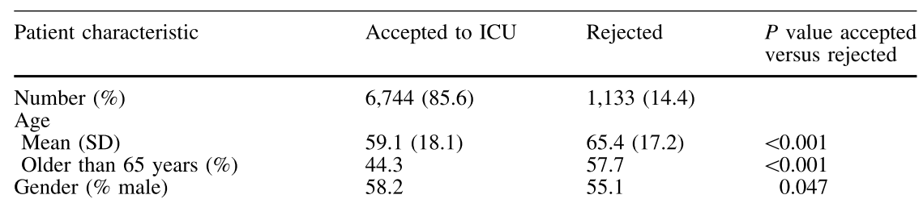
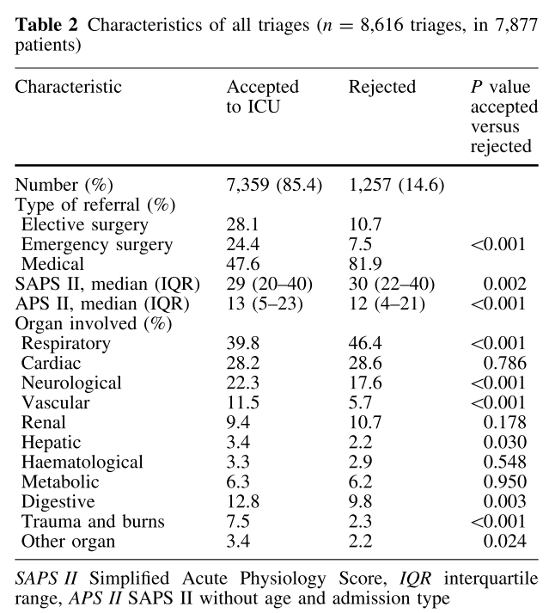
Iapichino G, Intensive Care Med 2010
Patients’ (n=7,877) characteristics at first ICU triage

Slide 12
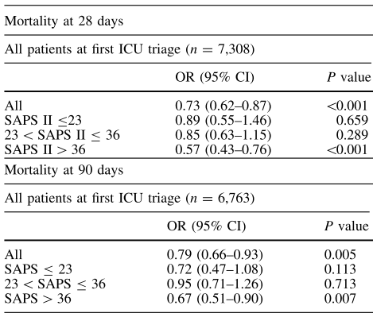
Iapichino G, Intensive Care Med 2010
Impact of ICU treatment on mortality, by SAPS score

Slide 13

?
Quindi …
… un anziano “complesso”, non dovrebbe essere trattato più aggressivamente?
Auguste Rodin, Il pensatore,
1880

Slide 14

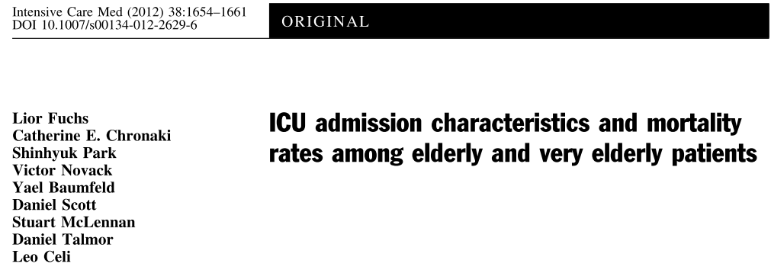
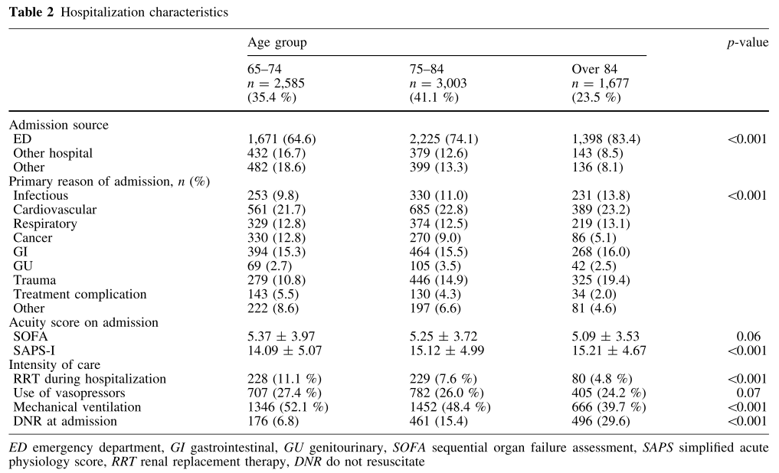

Slide 15

Ageismo:
Culturale e Clinico
L’esempio delle Sindromi Coronariche Acute
«Le due Fride». Frida Kalho 1939

Slide 16
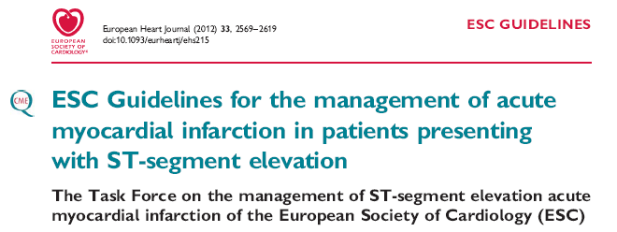
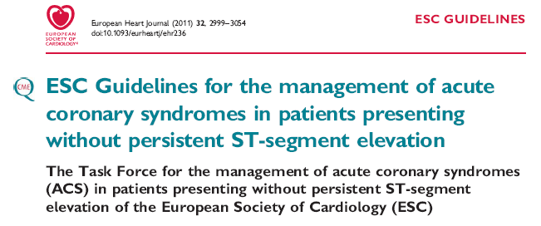
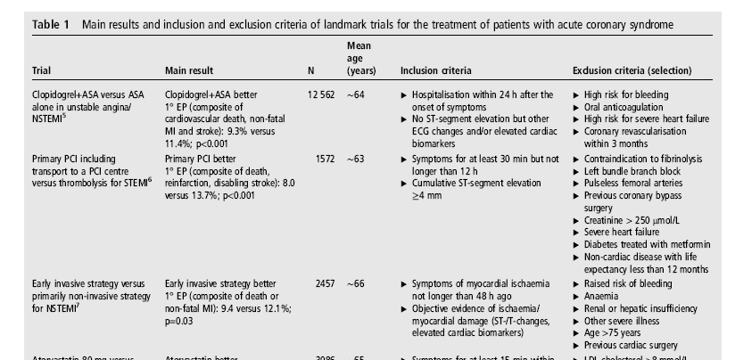
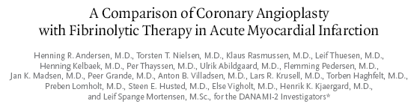
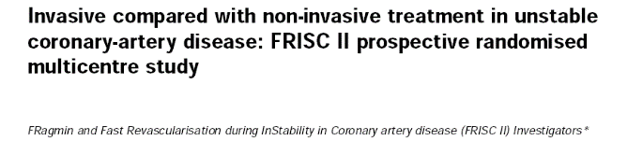
2012
2011
Maeder MT. Heart February 2014 Vol 100 No 4
DANAMI- 2 N Engl J Med 2003; 349:733–42
FRISC II Lancet 1999; 354:708–15
Maeder MT. Heart 2014; 100:268-70

Slide 17
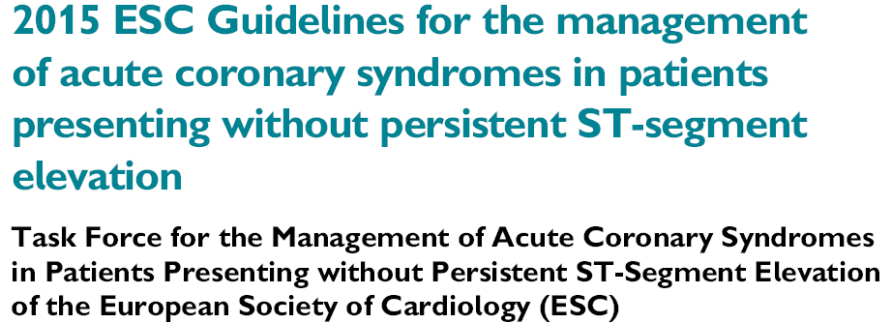
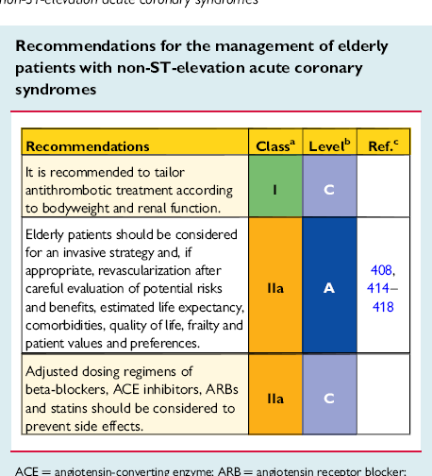
Eur Heart J 2016;37:267–315

Slide 18
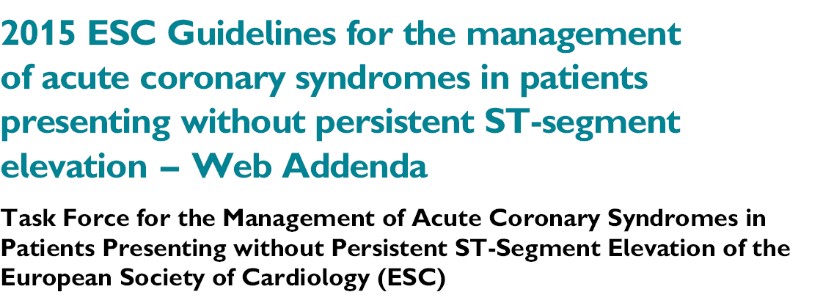
Eur Heart J doi:10.1093/eurheartj/ehv320
Elderly patients are less likely to receive EB therapies and undergo an invasive strategy
Despite [this], …benefit of early invasive strategy appears to be maintained at older age, as suggested by a subgroup analysis of TACTICS-TIMI 18
A propensity-adjusted analysis of the German ACS registry suggested that the invasive strategy in patients ≥75 years of age improved in-hospital mortality
In the Italian Elderly ACS RCT with 313 patients ≥75 years of age… the primary composite endpoint …was not significantly different between the invasive and the conservative groups [27.9% vs. 34.6%; HR 0.87 (95% CI 0.49, 1.56)], although these results cannot exclude a clinically important difference one way or the other

Slide 19
Evidence-based Therapies for the Elderly
with Acute Coronary Syndromes ?
Are older persons with ACS discriminated (i.e. not offered the best available treatment)?

Slide 20
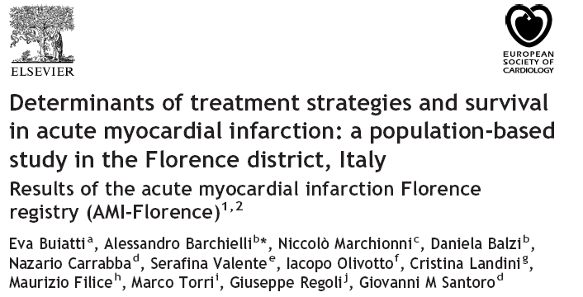
THE AMI-FLORENCE REGISTRY (analysis #1)
Buiatti E, et al. Eur Heart J 2003; 24:1195-203

Slide 21
THE AMI-FLORENCE REGISTRY (analysis #1)
STE-MI: enrollment & treatment
Enrolled
930
Admitted to Hospital
with PCI
390 (42.0%)
Admitted to Hospital
without PCI
540 (58.0%)
Conservative
therapy
90 (9.7%)
Thrombolysis
2 (0.2%)
Thrombolysis
43 (4.6%)
Conservative
therapy
334 (36.9%)
Primary PCI
298 (32.0%)
Transferal to Hospital
with PCI
163 (17.5%)
CONSERVATIVE
THERAPY
424 (45.6%)
Primary PCI
461 (49.6%)
REPERFUSION
THERAPY
506 (54.4%)
Buiatti E, et al. Eur Heart J 2003; 24:1195-203

Slide 22
THE AMI-FLORENCE REGISTRY (analysis #1)
6-month survival, by treatment
1.00
Thrombolysis (n 45, 4.8%)
PCI (n 461, 49.6%)
p<0.001
0.75
Conservative
therapy (n 424, 45.6%)
0.50
Cumulative Survival
0.25
0.00
0
2
4
6
Time to follow-up (months)
Buiatti E, et al. Eur Heart J 2003; 24:1195-203

Slide 23
THE AMI-FLORENCE REGISTRY (analysis #1)
Multivariate predictors of reperfusion therapy utilization
Buiatti E, et al. Eur Heart J 2003; 24:1195-203

Slide 24
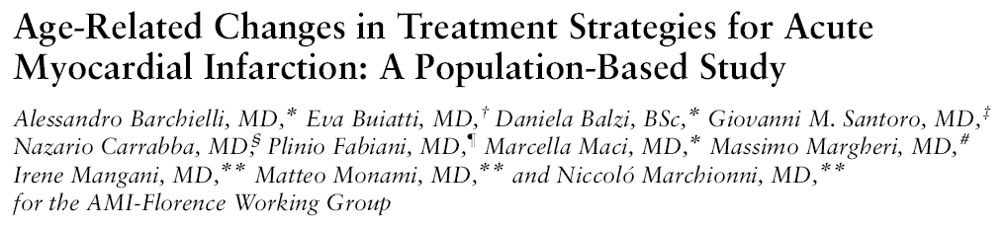

THE AMI-FLORENCE REGISTRY (analysis #2)
Background: guidelines indicate that coronary reperfusion therapy (CRT) is the first-choice treatment of STE-MI … primary PCI has been shown to reduce mortality and complications of STE-MI more markedly than thrombolysis … despite this, … CRT is still underused in advanced age.
Objectives: To compare across four age groups (<65, 65–74, 75–84, >85) the determinants of CRT use in STE-MI.
Barchielli A, et al. J Am Geriatr Soc 2004; 52:1355-60

Slide 25
THE AMI-FLORENCE REGISTRY (analysis #2)
Demographic & clinical characteristics, by age group
Age (years)
< 65
(n: 290)
65-74
(n: 246)
75-84
(n: 246)
>85
(n: 148)
p
Gender (males %)
85.9
71.5
58.1
43.9
<0.001
Comorbidities (n)
cardiovascular
0.37
0.58
0.88
0.93
<0.001
non-cardiovascular
0.60
1.04
1.35
1.33
<0.001
AMI Characteristics (%)
Killip class 1
90.0
74.4
54.1
43.9
Killip class 2
4.5
14.2
18.7
30.4
0.036
Killip class 3-4
5.6
11.4
27.3
25.8
non anterior, Q waves
54.5
44.3
40.2
25.2
0.008
non-Q
14.8
19.9
25.2
25.0
Hospital admission (%)
Directly to hosp. with PCI
52.8
43.1
34.6
31.1
<0.001
Transf. to hosp. with PCI
56.2
47.9
33.5
17.7
<0.001
Barchielli A, et al. J Am Geriatr Soc 2004; 52:1355-60

Slide 26
THE AMI-FLORENCE REGISTRY (analysis #2)
Multivariate predictors of coronary reperfusion therapy utilization,
by age group
Age (years)
<65
65-74
75-84
>85
Variable
OR
p
OR
p
OR
p
OR
p
Hospital with PCI *
5.10
<0.001
5.14
<0.001
3.18
0.001
3.23
0.009
Comorbidity ‡
0.76
0.21
0.67
0.02
0.63
0.004
0.46
<0.001
Killip class >1 #
0.19
0.10
0.03
<0.001
0.30
0.02
0.28
0.01
Non-anterior AMI °
0.59
0.17
0.30
0.004
0.84
0.61
1.15
0.78
Non-Q waves AMI °
0.06
<0.001
0.03
<0.001
0.08
<0.001
0.05
0.008
*: Yes vs. No; ‡ N° of chronic diseases; #: vs. Killip class 1; °: vs. anterior location
Barchielli A, et al. J Am Geriatr Soc 2004; 52:1355-60

Slide 27
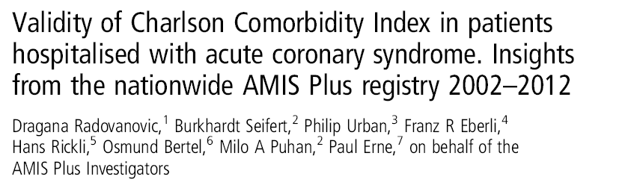
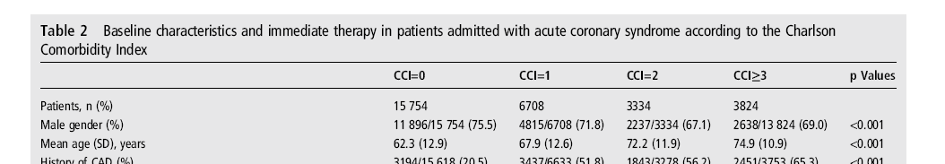
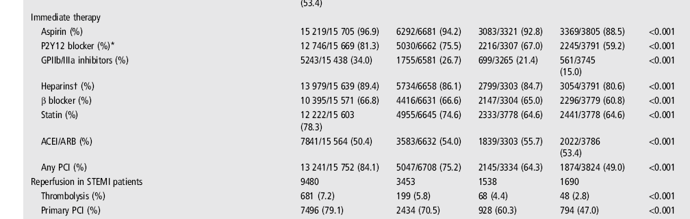
N = 29,620 ACS (2002-2012)
47% mean age >65 years
CCI = Charlson Comorbidity Index
Heart 2014; 100:288-94

Slide 28
Evidence-based Therapies for the Elderly
with Acute Coronary Syndromes ?
Are older persons with ACS discriminated (i.e. not offered the best available treatment)?
Is the denial (if any) of best treatment to older persons justifiable because of therapeutic futility (or following the “primum non nocere” principle)?

Slide 29

THE AMI-FLORENCE REGISTRY (analysis #3)
Effect of Comorbidity on Coronary Reperfusion Strategy and Long-Term Mortality after Acute Myocardial Infarction (the AMI-Florence Registry)
Daniela Balzi, Alessandro Barchielli, Eva Buiatti, Caterina Franceschini, Rinaldo Lavecchia, Matteo Monami, Giovanni Maria Santoro, Massimo Margheri, Iacopo Olivotto, Gian Franco Gensini, and Niccolò Marchionni, for the AMI-Florence Working Group
OBJECTIVES: …Studies suggest that a substantial proportion of eligible patients with STE-MI do not receive coronary reperfusion therapy (CRT), particularly when affected by chronic comorbidity... The present analysis is aimed at determining the impact of chronic comorbidity on CRT utilization and 1-year mortality in patients with STE-MI.
Balzi D, et al. Am Heart J 2006; 151:1094-100

Slide 30
THE AMI-FLORENCE REGISTRY (analysis #3)
Clinical characteristics, by Chronic Comorbidity Score (CCS)
CCS 1
n: 423
CCS 2
n: 229
CCS 3
n: 268
p
Age (years)
65.9 ± 13.0
71.9 ± 12.6
76.5 ± 9.5
<0.001
Killip class, n (%)
1
343 (81.1)
162 (70.7)
132 (49.3)
2
62 (14.7)
57 (24.9)
111 (41.0)
<0.001
3-4
18 (4. 3)
10 (4.4)
27 (9. 3)
AMI location, n (%)
Anterior, Q waves
153 (36.2)
82 (35.8)
73 (27.2)
Non-anterior, Q waves
209 (49.4)
95 (41.5)
119 (44.4)
<0.001
Non-Q waves
61 (14.4)
52 (22.7)
76 (28.4)
Hosp. admission, n (%)
Directly to hosp. with PCI
205 (48.5)
99 (43.2)
82 (30.6)
<0.001
Transf. to hosp. with PCI
188 (44.5)
49 (21.5)
55 (20.4)
<0.001
Therapy, n (%)
Conservative
122 (28.8)
112 (48.9)
182 (67.9)
<0.001
Coronary reperfusion
301 (71.2)
117 (51.1)
86 (32.1)
Balzi D, et al. Am Heart J 2006; 151:1094-100

Slide 31
THE AMI-FLORENCE REGISTRY (analysis #3)
1-year survival, by Chronic Comorbidity Score (CCS) & treatment
1.00
Coronary reperfusion
1.00
Coronary reperfusion
0.75
Conservative therapy
0.75
Conservative therapy
Cumulative survival
0.50
0.50
p = 0.185
p = 0.003
0.25
CCS 1
0.25
CCS 2
0.00
0.00
0
5
10
0
5
10
1.00
Coronary reperfusion
0.75
0.50
Conservative therapy
Cumulative survival
0.25
p = 0.002
CCS 3
Balzi D, et al. Am Heart J 2006; 151:1094-100
0.00
0
5
10
Time to follow-up (months)

Slide 32
THE AMI-FLORENCE REGISTRY
8-year follow-up analysis
Number needed to treat (NNT) for coronary
reperfusion therapy at various time of follow-up,
by age at STE-MI onset
Barchielli A, et al. J Cardiovasc Med 2012; 13:819-27

Slide 33

The idea
Di Bari M, et al. J Gerontol A Biol Sci Med Sci. 2009
Identifying elderly “at risk” using only administrative data
Advantages:
  Prognostic stratification rapid, low-cost, objective, virtually pre-hospital
  Risk adjustment in horizontal (across facilities or units) and vertical (across time) comparisons
To assess possible advantages, risk-adjusted, of admission of older, complex patients to an Acute Geriatrics versus Internal Medicine Unit

Slide 34
AMI Florence 2 – Silver Code in Acute Coronary Syndromes (ACS)
BACKGROUND
  Incidence of, and fatality from, ACS increase markedly with advancing age
  Percutaneous coronary intervention (PCI) is recommended as the first-line treatment of ACS irrespective of age, but is systematically underused in older, frail individuals
AIMS
  To verify whether Silver Code predicts application of PCI during ACS
  To assess whether, within Silver Code classes, application of PCI improves survival
Heart 2014; 0:1–6. doi:10.1136/heartjnl-2013-305445
Notes:
34
34

Slide 35
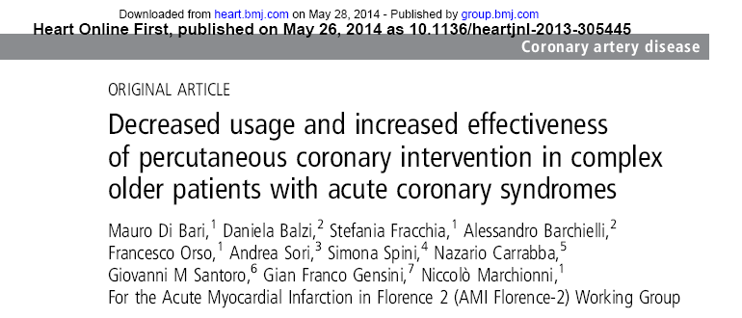
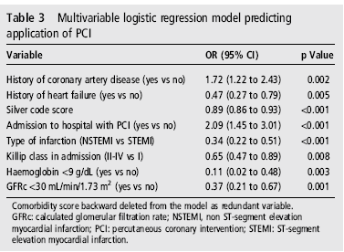
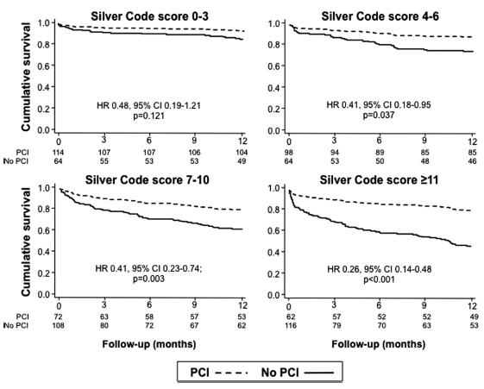
Heart 2014; 0:1–6. doi:10.1136/heartjnl-2013-305445

Slide 36
Pintado MC et al The Scientific World Journal 2013
Conclusions. Prior functional status and comorbidity … can help us to make the right decision of admitting or refusing to ICU patients older than 75 yrs
Ma chi, deve decidere?

Slide 37
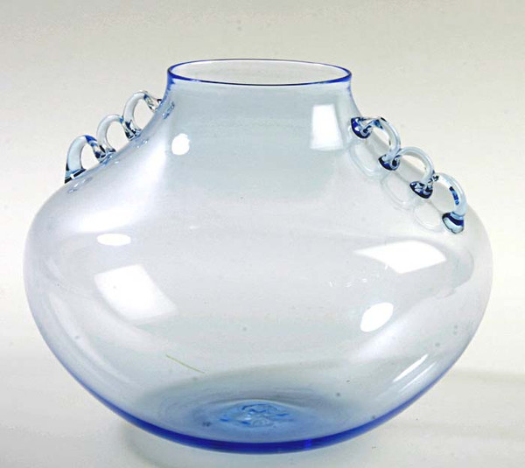

I geriatri, gli specialisti di complessità e fragilità: la Geriatria non è per i deboli di cuore …
Fragilità in ICU
Sarcopenia
Delirium
Stress emozionale
Napoleone Martinuzzi
(Murano, 1892 – Venezia, 1977)

Slide 38
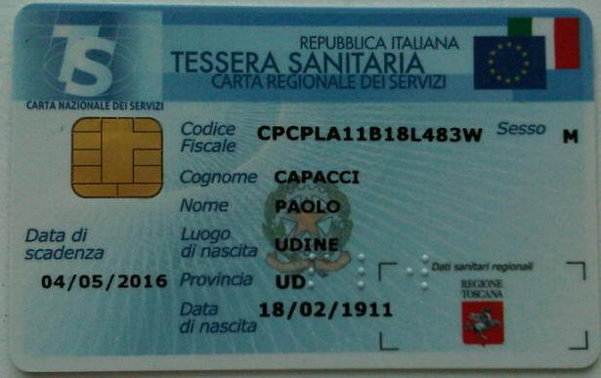
Older patients in ICU - Lesson learned from narrative medicine
(the case of Paolo C. March 23, 2011)
Age?
100 years and.. 35 days !!

Slide 39
Past clinical history
Hypertension treated with ACE-inhibitors, β-blockers and Ca-antagonists
Moderate-severe CKD (1.6-1.8 mg/dL; eGFR 35 ml/min/1.73m²)
10 years before endoscopic surgery for bladder papilloma
8 years before surgery for malignant melanoma
2 years before ACS treated conservatively. Moderate LV systolic dysfunction (LVEF 35%). NYHA class II
Cognitively intact and independent in ADL; participates in a rich familiar and social network: NOT frail !
but …

Slide 40
Present clinical history
March 20, 2011: exertional dyspnea, progressing to dyspnea at rest over 48 hours
March 23, 2011: pulmonary edema and anuria
Addressed by GP to the Geriatric ICU at Azienda Ospedaliero-Universitaria Careggi, Florence, Italy

Slide 41
Hospital admission
ABP 100/60 mmHg, HR 120 b/min
Cardiac auscultation: 3/6 Levine systolic murmur at apex
Thoracic auscultation: rales over the whole lung area
ECG: incomplete LBB; ST-segment depression in DI, aVL, V4-V6
Echocardiogram: LVEF 25%

Slide 42
Laboratory exams
23.3.10 h 16.00
23.3.10 h 18.00
TnI 42 ng/ml
CKMb 134 ng/ml
Creatinine 2.38 mg/dl
(GFR 20 ml/min/1.73m²)
K+ 6.7 mEq/l
Arterial pH 7.37, O₂Sat 85% (FIO₂ 50%), lactate 4.3 mmol/L, BE -9 mmol/L
TnI 49 ng/ml
CKMb 104 ng/ml
Creatinine 2.71 mg/dl

Slide 43
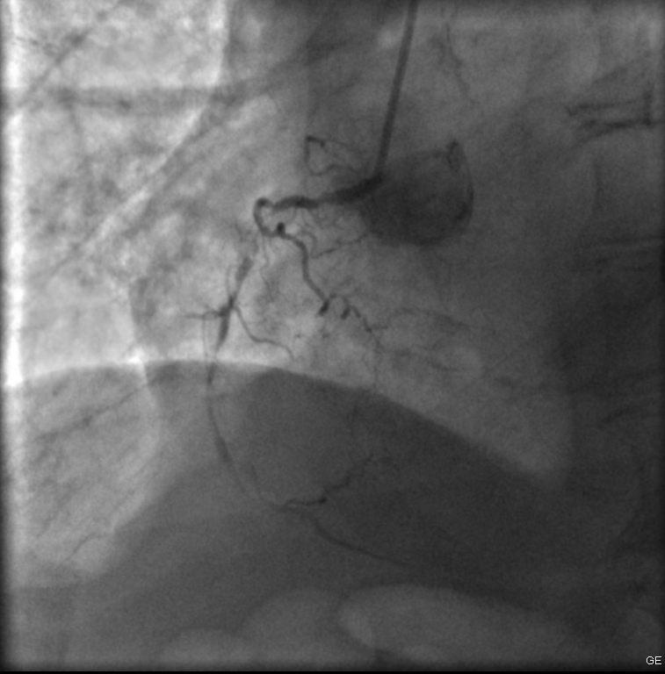
Cath. Lab.: Right coronary artery

Slide 44
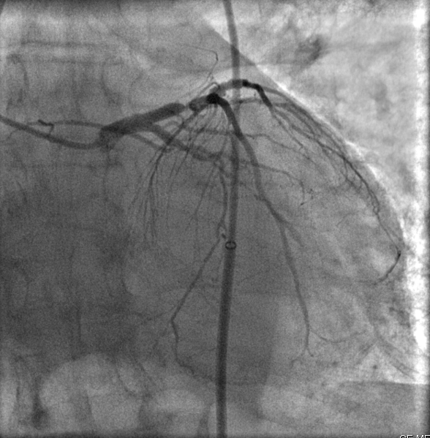
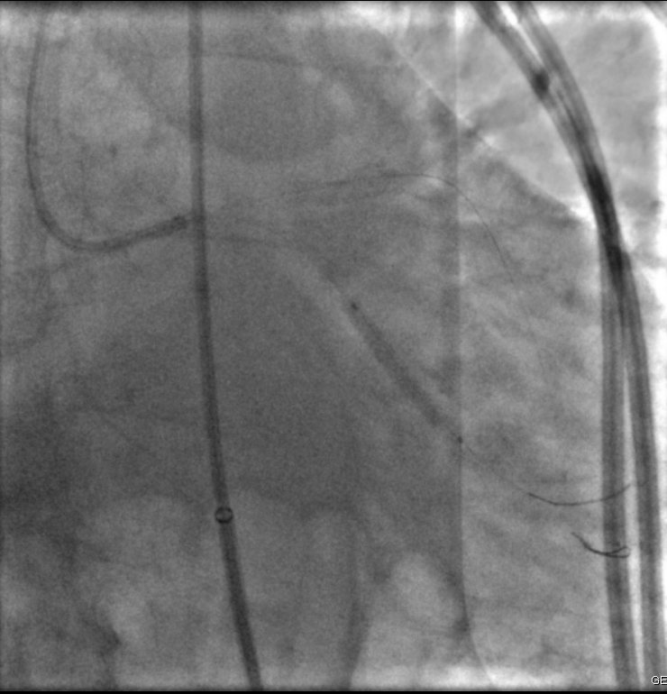
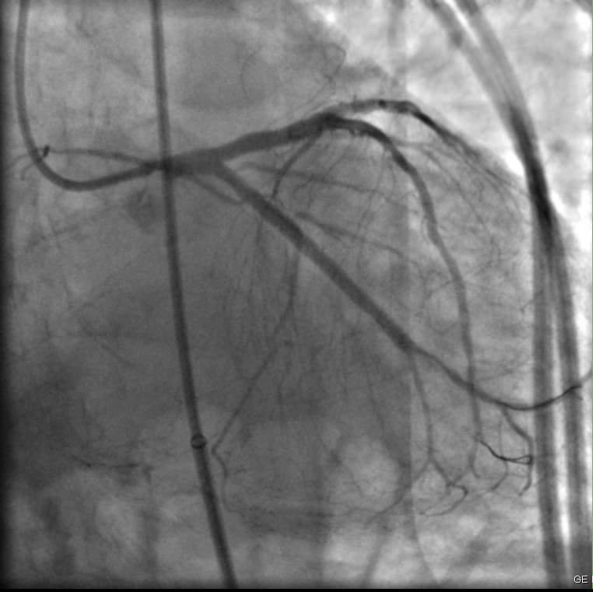
Cath. Lab.: Left coronary artery

Slide 45
Subsequent in-hospital stay
In the cath. lab., a bi-lumen 12F catheter was inserted into the right femoral vein for CVVHDF (24 hours)
After 5 days …
Asymptomatic, ABP 120/60 mmHg; HR 64 b/min
Good diuresis (creatinine reduced to 1.8, and stable)
No complication
Left ventricular ejection fraction remarkably improved to 45%
Discharged on April 2, 2011 (LoS: 8 days), independent in BADL …

Slide 46
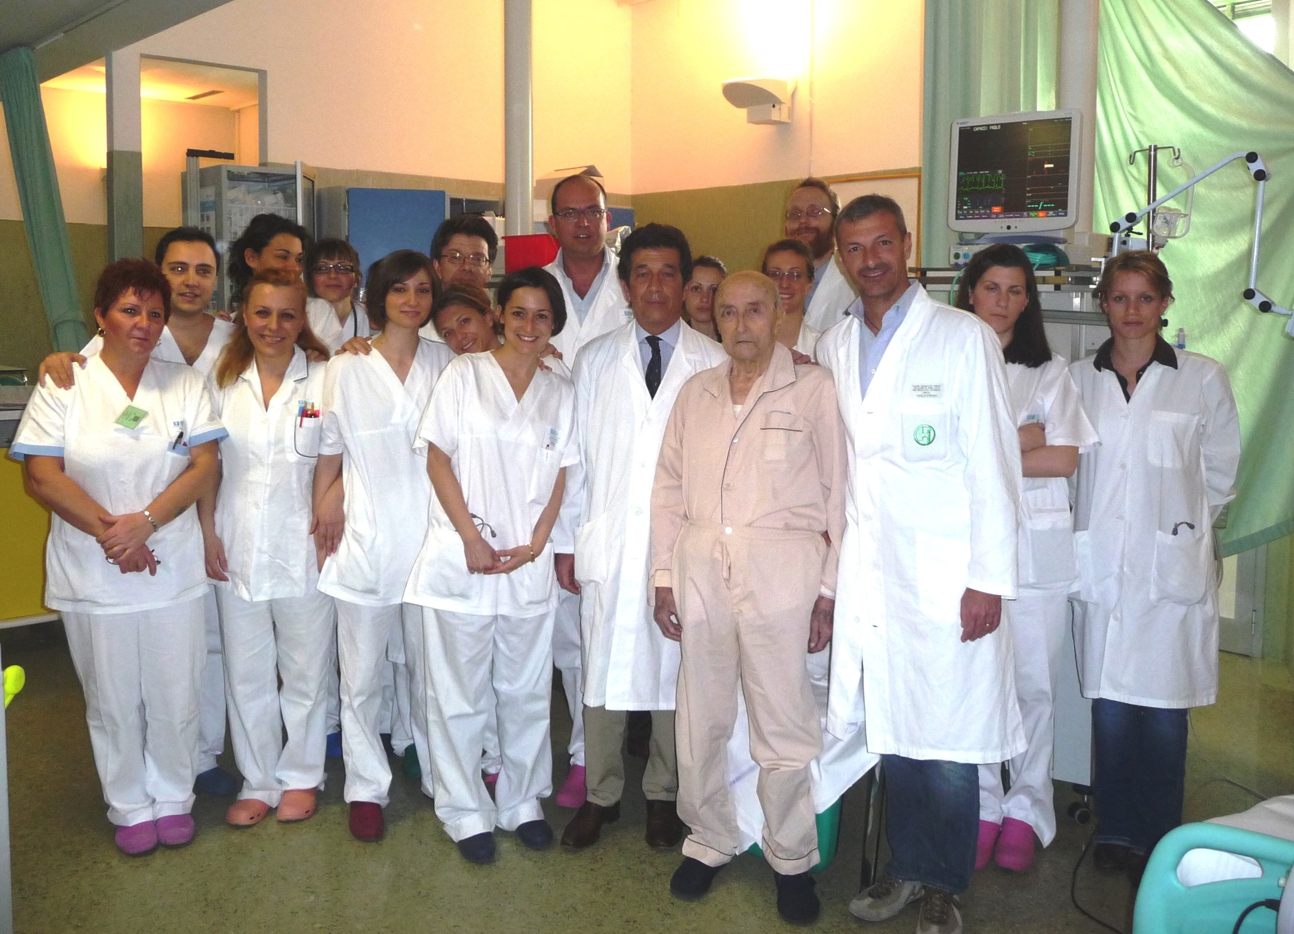
Aggressive, E-B therapies for Paolo C.:
have they been worthwhile?

Slide 47
I geriatri, gli specialisti di complessità e fragilità: la Geriatria non è per i deboli di cuore …
Fragilità in ICU
Delirium
Stress emozionale
Napoleone Martinuzzi
(Murano, 1892 – Venezia, 1977)

Slide 48
Delirium in ICU
N = 126 patients in Pistoia
(Cardiology Division)
N = 373 patients in Florence
(Geriatric Cardiology Division)
N = 499
total patients
N = 91
delirium cases
(18%)
N = 44 prevalent cases
(on admission)
9%
N = 47 incident cases
(onset ≥24 hours after admission)
9%
Mossello E et al., EUGMS, Rotterdam, 2014

Slide 49
Factors independently associated with delirium
 | OR [95% CI] | p
Age | 1.04 [1.0 - 1.1] | 0.04
ADL disability | 1.1 [0.98 - 1.3] | 0.093
Charlson Index | 1.1 [1.0 - 1.3] | 0.024
Dementia | 3.5 [1.9 - 6.4] | < 0.001
Modified REMS # | 1.2 [1.1 - 1.3] | < 0.001
STEMI * | 4.4 [2.0 - 10.1] | < 0.001
Respiratory failure * | 10.9 [2.7 - 44.3] | 0.001
# Rapid Emergency Score
* vs. angina/NSTEMI
Mossello E et al., EUGMS, Rotterdam, 2014

Slide 50
Factors independently associated with in-hospital mortality
 | OR [95% CI] | p
Age | 1.1 [1.0 - 1.2] | 0.008
ADL disability | 1.5 [0.9 - 2.3] | 0.081
Charlson Index | 1.1 [0.9 - 1.4] | 0.383
Dementia | 4.7 [0.9 - 25.4] | 0.069
Modified REMS # | 1.2 [1.1 - 1.4] | 0.022
Delirium | 3.3 [1.1 - 10.4] | 0.039
Respiratory failure * | 11.9 [1.1 - 129.2] | 0.042
Other diagnosis * | 5.9 [1.1 - 32.0] | 0.038
# Rapid Emergency Score
* vs. angina/NSTEMI
Mossello E et al., EUGMS, Rotterdam, 2014

Slide 51
Trattamento dell'agitazione psicomotoria e rischio di morte cardiaca improvvisa
Rischio di morte cardiaca improvvisa: confronto di 44.218 trattati con antipsicotici tipici e 46.089 trattati con atipici vs. 186.600 non trattati con antipsicotici
Ray WA et al., N Engl J Med, 2009

Slide 52
Older Patients in ICUs &
Emotional Distress
An “ICU syndrome” is particularly frequent among older, critically ill patients
  Elderly Patient’s Experiences of Pain and Distress in Intensive Care: A Grounded Theory Study
  (Hall-Lord ML, et al. Intensive Crit Care Nurs 1994)
  Stress and the Intensive Care Patient: Perceptions of Patients and Nurses
  (Cornock MA, J Adv Nurs 1998)

Slide 53
L'agitazione psicomotoria può causare danni cardiovascolari?
La sindrome di Tako-Tsubo
Casi di morte cardiaca improvvisa descritti in corso di agitazione psicomotoria acuta, particolarmente in associazione all'utilizzo di contenzioni
La sindrome di Tako-Tsubo: dolore toracico con a-discinesia antero-apicale del VS in assenza di stenosi coronariche
Tipicamente scatenata da stress emotivo (> sesso femminile)
Può essere causa di edema polmonare acuto o aritmia ventricolare
Un caso di delirium ipercinetico in donna ottantenne associato al quadro ecografico di Tako-Tsubo
Otahbachi M et al., Am J Forensic Med Pathol 2010
Nguyen H et al., Permanente J, 2012

Slide 54
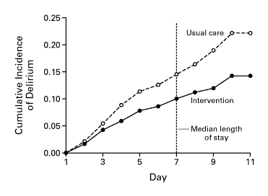
Quali strategie assistenziali di prevenzione del delirium in ICU geriatrica?
?
A Multicomponent Intervention to Prevent Delirium in Hospitalized Older Patients
  Inouye SK, N Engl J Med 1999; 340:669-676

Slide 55
Quali strategie assistenziali di prevenzione dello stress emozionale in ICU geriatrica?
?
Increasing visits by relatives might affect favorably some outcome of the critically ill in ICU [though it might increase the risk of septic complications]
  ABC of Intensive Care: Other Supportive Care
  (Adam S, et al. Br Med J 1999)

Slide 56
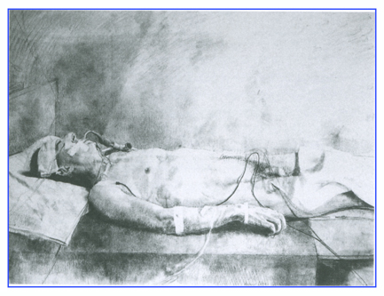
“Hombre Operado”, 1969
Antonio Lòpez Garcìa
Tomelloso, Spain
1936 - living

Slide 57
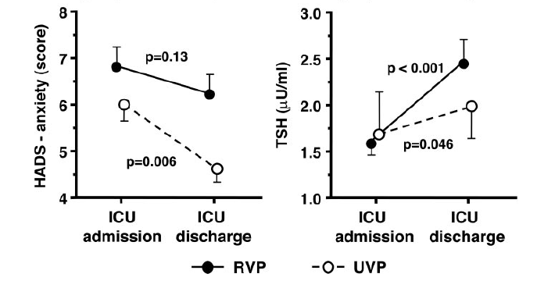
Fumagalli S et al, Circulation 2006; 113:946-52

Slide 58
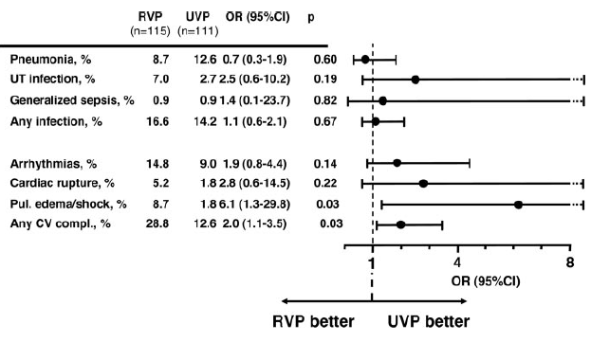
Fumagalli S et al, Circulation 2006; 113:946-52

Slide 59



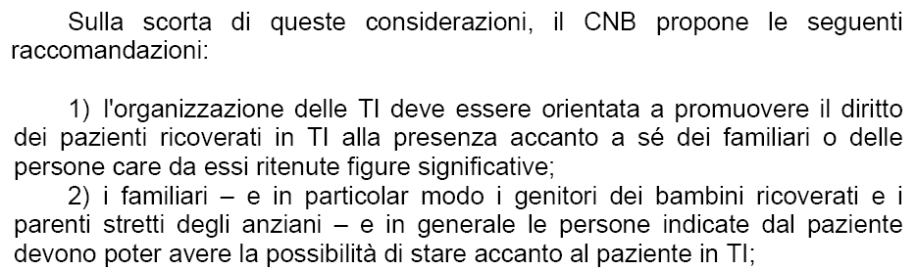
Dopo “solo” sette anni…

Slide 60
Incidenza e predittori di delirium post-CCH

Slide 61
Probabilità di delirium in modello comprendente frazione d’eiezione
del VS (FE) e Short Physical Performance Battery (SPPB)
0.80
Gruppo B vs A = 4.45; 1.30-15.06 (OR ;95% CI)
0.60
Probabilità
0.40
Gruppo B
0.20
Gruppo A
0.00
20
40
60
80
FE
Gruppo A= SPPB= 7-12 punti
Gruppo B= SPPB 0-6 punti

Slide 62
L’ANZIANO NELLE TERAPIE INTENSIVE
Conclusioni
Gli anziani sono prevalenti in ICU, ma atteggiamenti ageisti incidono negativamente ancor prima del ricovero, con frequente rifiuto già in fase di triage
La decisione sul ricovero in ICU di un anziano deve essere frutto di un processo di triage che comprenda gli elementi tipici della VMD: geriatra!
L’ageismo in ICU si traduce in sistematica sottoutilizzazione età-associata di terapie EBM, nonostante un loro maggior beneficio prognostico, non solo a breve termine

Slide 63
L’ANZIANO NELLE TERAPIE INTENSIVE
Conclusioni
Per un anziano il ricovero in ICU è un evento altamente traumatico, ad alto rischio di delirium e agitazione psicomotoria, da trattare più con misure ambientali “dolci” che con farmaci o contenzione
L’identificazione della fragilità fisica come fattore di rischio di delirium (e altri outcome avversi) in ICU dopo CCH elettiva apre la strada a possibili studi di pre-habilitation

Slide 64
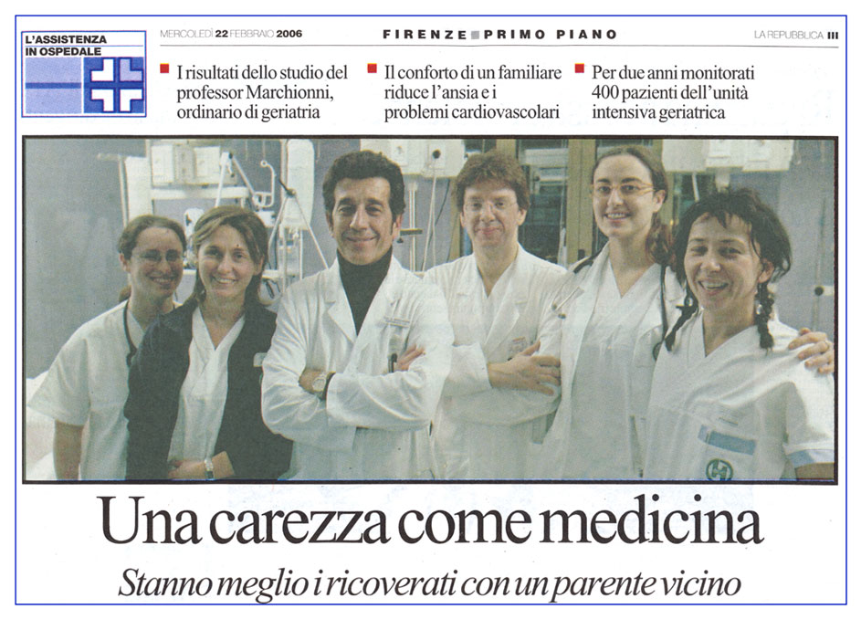
Una carezza come medicina

